Slide 1


Kammavari Sangham (R) 1952, K.S.Group of Institutions
K. S SCHOOL OF ENGINEERING AND MANAGEMENT, BENGALURU-560109 (Affiliated to VTU, Belagavi & Approved by AICTE, New Delhi, Accredited by NAAC)
DEPARTMENT OF ARTIFICIAL INTELLIGENCE & DATA SCIENCE
Internship Project Review on
“CONTEXTUAL LANGUAGE UNDERDTANDING WITH TRANSFORMER MODELS”
Internship Coordinator
Prof. Madhusmita Mishra
Assistant professor
Dept., of AI & DS, KSSEM
Presented by:
RUCHITHA B J
SHANTHREDDY
SWARNASHREE D S ANOOP B
1KG21AD042 1KG21AD044 1KG21AD050 1KG22AD400

Slide 2
AGENDA
About the Company
Introduction
Problem Statement
Methodology
Hardware & Software Requirements
Project Outline & Screenshots
Conclusion
Thank You
Slide no: 01

Slide 3
ABOUT THE COMPANY
Rooman Technologies Pvt. Ltd. offered a comprehensive program covering Python programming fundamentals, control structures, data structures, file handling, and database integration. It also included AI-focused sessions on prompt engineering and using AI coding assistants, along with hands-on web development using Flask with authentication and database connectivity. The course explored core cloud computing services, DevOps practices, and orchestration tools like Kubernetes across AWS, Azure, and GKE. Data-related modules focused on data cleaning, analysis, visualization, and implementing machine learning models using Power BI. Networking concepts such as TCP/IP, subnetting, and troubleshooting were also thoroughly covered.
IBM’s course provided an in-depth journey into machine learning, covering the entire lifecycle from data pre-processing to model evaluation using Python, Scikit-Learn, Pandas, and Numpy. It integrated IBM Cloud Services and Watson, demonstrating their role in AI workflows. The course emphasized hands-on learning through a structured weekly progression, ensuring a strong grasp of core ML concepts. In addition to technical training, it introduced agile methodologies, design thinking, and version control with Git and GitHub, fostering a well-rounded approach to AI and software development.
Slide no: 02

Slide 4
INTRODUCTION
Contextual Language Understanding (CLU) is a foundational task in natural language processing (NLP) that aims to interpret language by capturing the underlying context. Traditional models, based on bag-of-words and statistical techniques, fall short in understanding this context, especially in ambiguous or semantically rich text, which limits their effectiveness for tasks like sentiment analysis. With the advent of transformer architectures such as BERT, DistilBERT, and RoBERTa, CLU has seen significant improvements. These models leverage self-attention mechanisms to understand the meaning of a word based on its surrounding context, making them highly effective for discerning emotional tone.
This project explores CLU for sentiment analysis through benchmark tasks provided by the General Language Understanding Evaluation (GLUE) dataset, specifically SST-2. The goal is to fine-tune and utilize transformer models like DistilBERT and RoBERTa, evaluate their contextual understanding for sentiment, and assess their effectiveness in real-world applications.
Slide no: 03

Slide 5
PROBLEM STATEMENT
Despite the growing abundance of textual data from customer reviews, social media, and feedback channels, organizations struggle to extract reliable and nuanced sentiment insights at scale.
Traditional sentiment analysis techniques, heavily reliant on lexical rules or simple statistical models, often fall short.
They frequently misinterpret contextual nuances, such as sarcasm, double negatives, or subtle emotional cues inherent in human language.
This leads to inaccurate sentiment classification, hindering effective decision-making in areas like customer satisfaction, product development, and market analysis.
There is a pressing need for an advanced, context-aware sentiment analysis solution that can accurately interpret complex language, providing actionable and trustworthy insights for real-world applications, while also being deployable in restricted environments.
Slide no: 04

Slide 6
METHODOLOGY
The methodology is divided into four systematic phases:
Phase 1: Data Collection and Understanding
Identify benchmark dataset: GLUE (SST-2) for sentiment.
Select Transformer models: DistilBERT and RoBERTa.
Acquire model files locally for offline use (one-time).
Analyze dataset structure and sentiment labels.
Phase 2: Data Cleaning and Preprocessing
Tokenize raw text using specific model tokenizers.
Format inputs (IDs, attention masks) for Transformers.
Standardize sequence lengths (padding/truncation).
Map sentiment labels to numerical representations.
Slide no: 05

Slide 7
METHODOLOGY
Phase 3: Model Training and Evaluation
Load pre-trained Transformer models.
Fine-tune models on the SST-2 sentiment dataset.
Evaluate model performance using key metrics (e.g., F1-score).
Refine logic for "Positive," "Negative," and "Neutral" classification.
Phase 4: Deployment and Web Interface
Integrate locally stored models for sentiment inference.
Design user-friendly input and output interface.
Ensure project is packaged for secure, self-contained deployment.
Slide no: 06

Slide 8
HARDWARE AND SOFTWARE REQUIREMENTS
Hardware Requirements | Software Requirements
Processor: Dual-Core or higher | Programming Language: Python 3.9+
RAM: Minimum 4 GB | Libraries/Packages: streamlit, transformers, torch, numpy, scipy.
Storage: At least 2 GB | IDE: VS Code
Internet: Required for model download. | Operating System: Windows, Linux, or macOS
 | Web Framework: Streamlit
 | Virtual Environment: venv
Slide no: 07

Slide 9
PROJECT OUTLINE & SCREENSHOTS
The Advanced Sentiment Analysis App is an interactive, web-based application designed for real-time sentiment analysis of user-provided text. It leverages state-of-the-art Transformer models, specifically DistilBERT and RoBERTa, to perform highly accurate classification of sentiment into Positive, Negative, and Neutral categories. Built with Streamlit, the application delivers immediate results through an intuitive, easy-to-use interface.
User Interface Overview
Home Page
Users are greeted with a welcoming dashboard featuring the title "Welcome to the Advanced Sentiment Analysis App".
A brief description clarifies the app's purpose: "This application allows you to analyze the sentiment of any text you provide."
A prominent "Get Started: Analyze Sentiment" button serves as a clear call to action, guiding users to the core functionality.
A navigation sidebar on the left provides access to "Home," "Analyze Sentiment," "Sentiment Results," and "Analysis History" sections.
Slide no: 08

Slide 10
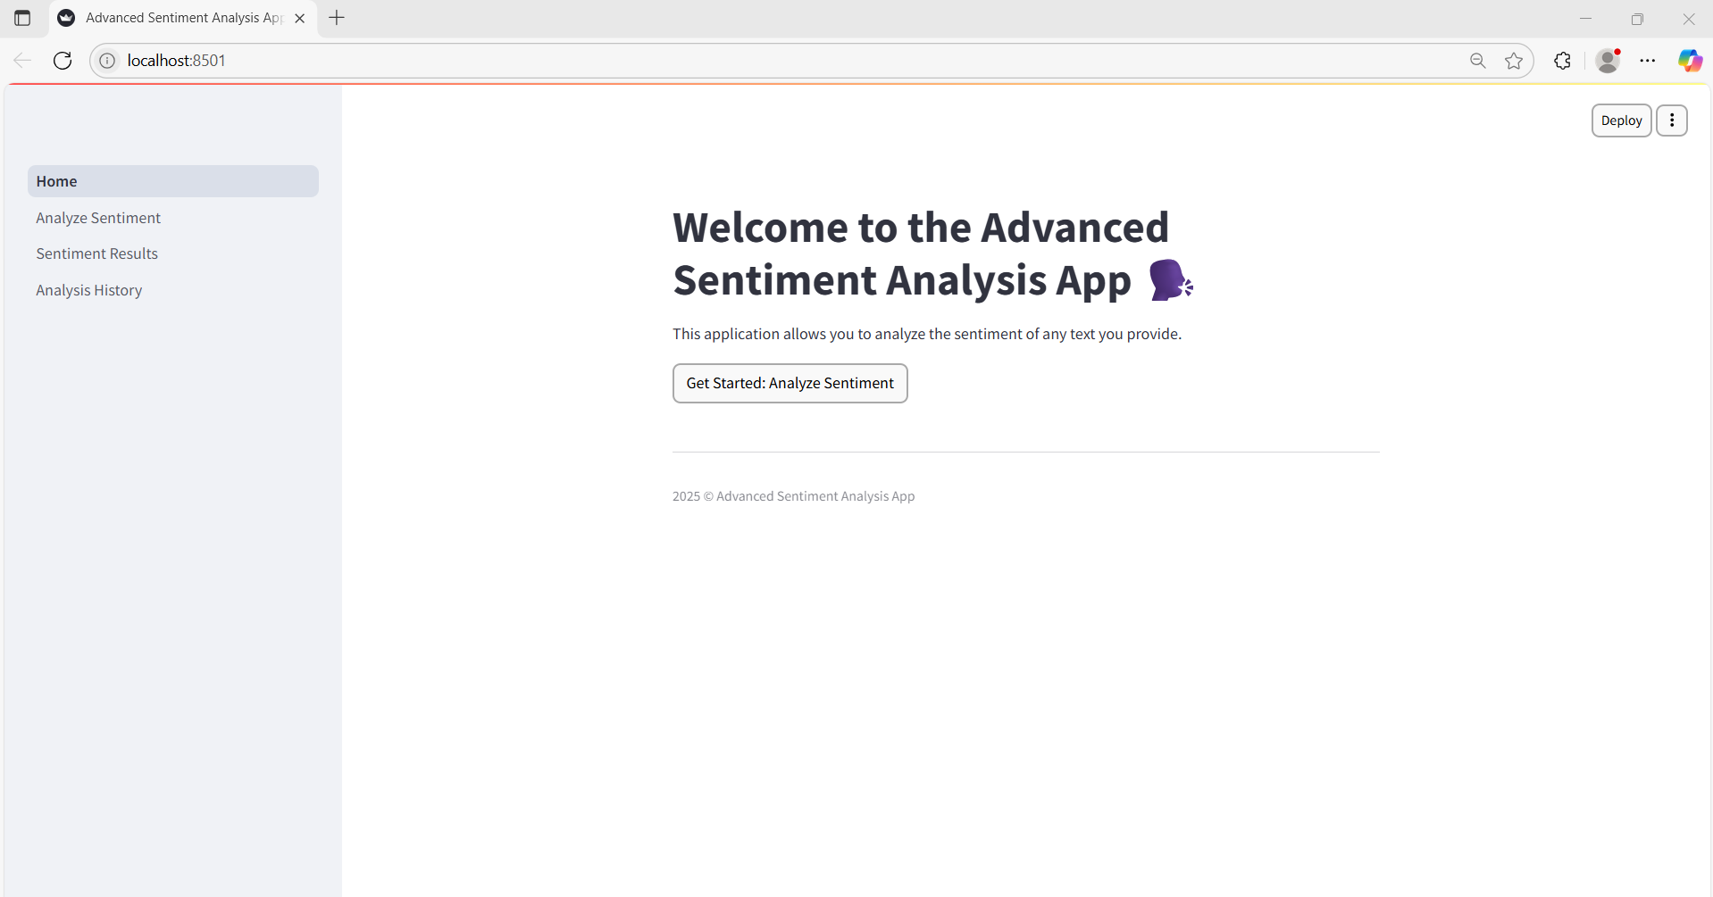
PROJECT OUTLINE & SCREENSHOTS
Screenshot of Home Page
Slide no: 09

Slide 11
PROJECT OUTLINE & SCREENSHOTS
2. Analyze Sentiment Page
This page is clearly titled "Enter Text for Sentiment Analysis," instructing users to type or paste text for sentiment analysis.
Users can conveniently select their preferred Transformer model from a dropdown: DistilBERT for Positive and Negative sentiment or RoBERTa for explicit Positive, Negative, and Neutral classifications.
A large text input box is provided for custom text entry, accompanied by a "Quick Examples" section with a dropdown for instant testing with pre-defined sentences.
The interaction is driven by an "Analyze Sentiment" button to process the input, alongside a "Clear Input" button for easily resetting the text field.
Slide no: 10

Slide 12
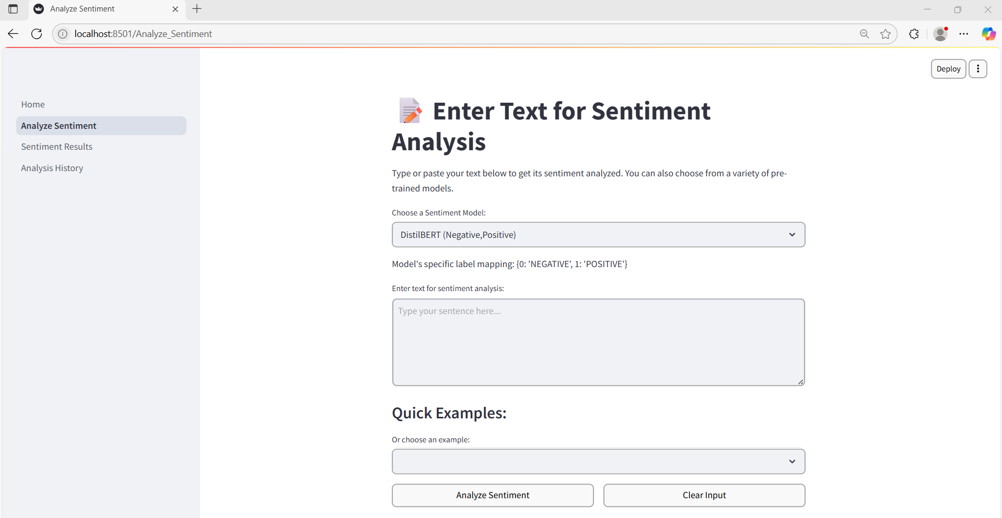
PROJECT OUTLINE & SCREENSHOTS
Screenshot of Analyze Sentiment Page
Slide no: 11

Slide 13
PROJECT OUTLINE & SCREENSHOTS
3. Sentiment Results Page
This page displays the comprehensive outcome of the sentiment analysis, clearly titled "Current Sentiment Analysis Results."
It prominently shows the Original Text that was analyzed, details the Model Used for prediction (e.g., RoBERTa with its label mapping), and provides the Analysis Time.
An "Analysis Summary" section presents the Overall Sentiment (e.g., Negative, highlighted visually) along with the prediction's Confidence Score.
A dedicated section for "Raw Probability Scores" breaks down the likelihood for each sentiment class (e.g., Negative, Neutral, Positive) with exact percentages.
At the bottom, users are provided with actionable buttons to "Analyze Another Text" or "View Analysis History," facilitating further interaction.

Slide 14
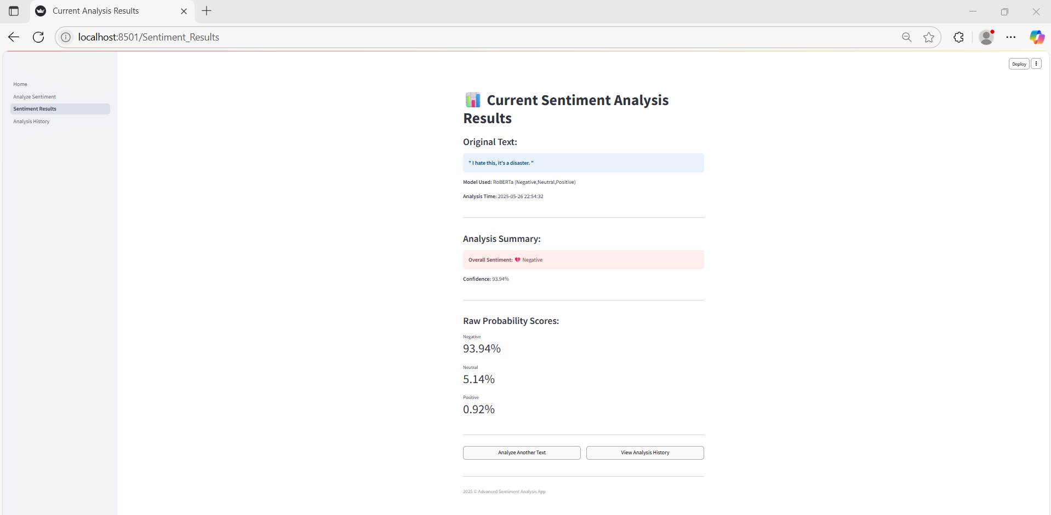
PROJECT OUTLINE & SCREENSHOTS
Screenshot of Sentiment Results Page

Slide 15
PROJECT OUTLINE & SCREENSHOTS
4. Analysis History Page
This page provides a record of past sentiment analyses, with each entry clearly labeled (e.g., "Analysis #1") and timestamped.
For each historical entry, the Original Text, its determined Sentiment (with confidence score), and the specific Model Used for that analysis are displayed.
Users can optionally expand to view the Raw Probabilities for any past analysis, offering deeper insight into the prediction.
Action buttons allow users to "Clear History" to remove all recorded analyses or "Go to Analyze Sentiment Page" to perform a new analysis.
A clear disclaimer informs users that the history is automatically cleared when the browser tab is closed.

Slide 16
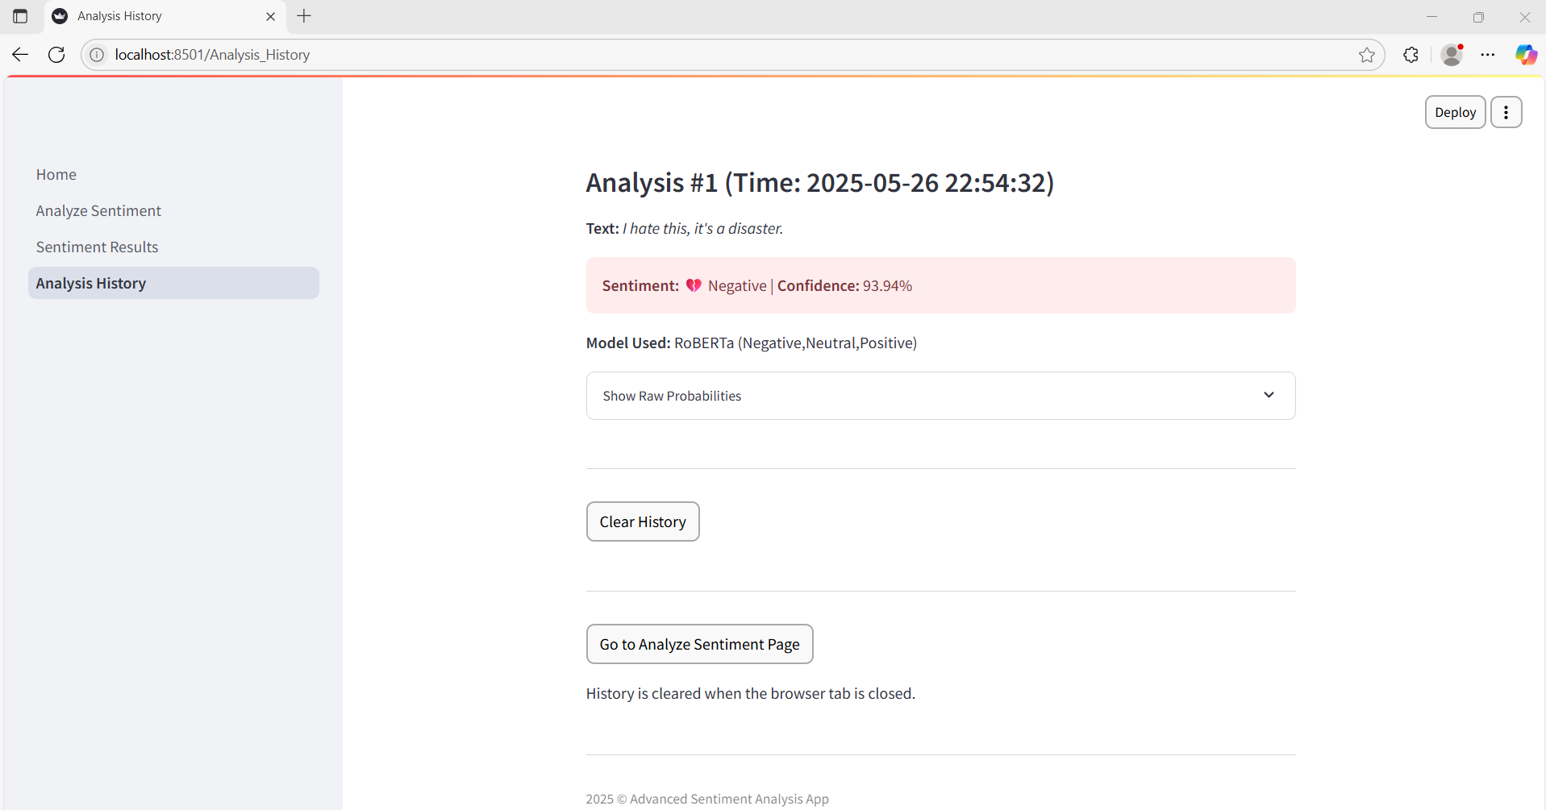
PROJECT OUTLINE & SCREENSHOTS
Screenshot of Analysis History Page

Slide 17
CONCLUSION
In conclusion, this project successfully developed an Advanced Sentiment Analysis App that leverages Contextual Language Understanding (CLU) through state-of-the-art DistilBERT and RoBERTa Transformer models. We've delivered a highly accurate solution for classifying text into Positive, Negative, and Neutral sentiments, accessible via an intuitive Streamlit web interface. Critically, by integrating locally stored models, our application ensures secure, efficient, and self-contained operation, providing valuable, context-aware insights for diverse real-world applications.
Slide no: 12

